Slide 1
International Business Development
Professor David Stokes
Kingston University, London
CoolLED Ltd.

Slide 2
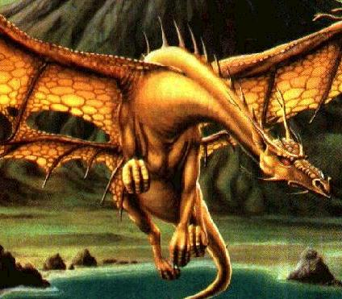
Myths about business development
“Business development is not about transactions; its about relationships”
“Social Media
Marketing
has changed
all the rules”

Slide 3
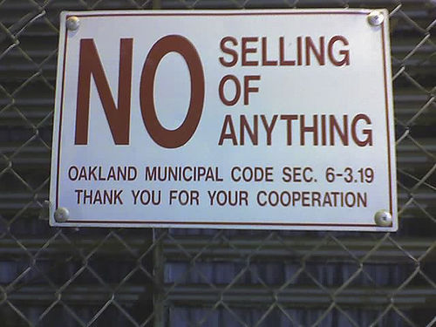
Business development is about taking orders: SELLING!
Business development is attracting and retaining customers
It is about selling,
taking the order,
as well as
relationships
International Business Development is selling to the world!

Slide 4
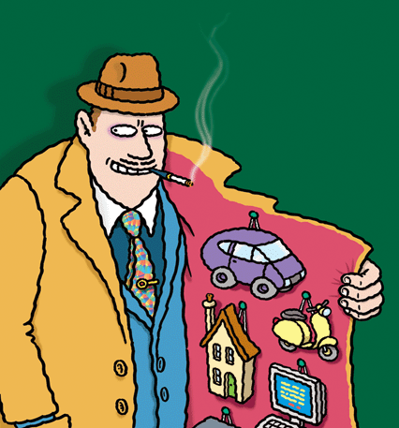
WHAT IS SELLING?
‘A process of effective communications about what is on offer in relation to customers’ needs’
What makes a good
sales person?

Slide 5
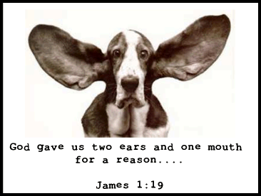
The number one skill of the salesperson
Questioning and listening

Slide 6
Which type of selling do you need?
CUSTOMER EXPERIENCE
High
Relationship building Order taking
PRODUCT High Low
COMPLEXITY
Consultative selling ‘Harder’ sales process
Low

Slide 7
Most entrepreneurs let others bring potential customers to them
Recommendations from customers is most popular method of acquiring customers in virtually all sectors and sizes of SMEs
Recommendations from other sources (non-customers) is often the second most popular method
Recommendations from customers is ranked as most effective method, including fast growth and most profitable firms
Other interactive methods, especially personal selling also preferred

Slide 8
Word of Mouth Marketing
“Impartial, personal communications”
Power of impartiality – can be undermined
Recommendations can be positive or negative
Face-to-face communications supplemented by internet and social media: Amazon, Facebook, Twitter, YouTube

Slide 9
Word of Mouth to Word of Mouse
Impartiality conditioned by media
 |  | Social presence (media richness)
 |  | Low | Medium | High
Self-presence (self-disclosure) | High | Blogs | Social networking sites (e.g. Facebook) | Virtual social worlds (e.g. Second Life)
 | Low | Collaborative projects (e.g. Wikipedia) | Content communities (e.g. YouTube) | Virtual game worlds (e.g. World of Warcraft)

Slide 10
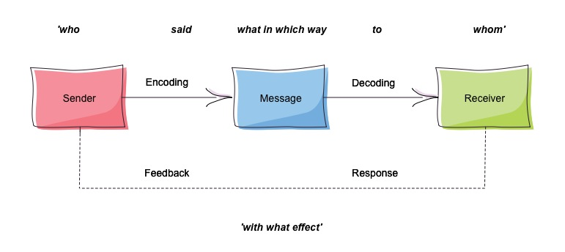
Word of Mouth communications process self-contained system that can be limiting

Slide 11
Word of Mouse communications process potential for faster, wider, viral messaging

Slide 12
Customer need for recommendations
CUSTOMER EXPERIENCE*
High
medium low
PRODUCT High Low
COMPLEXITY
high medium
Low
*Experience includes product and origin of supplier

Slide 13
Word of mouth/mouse marketing strategy
Find out about the recommending and complaining behaviour of your customers - who, what and when
Develop a strategy to minimise negative word of mouth
Develop a strategy to generate more positive recommendations and referrals
Pro-active not reactive

Slide 14
Word of mouth/mouse processes: who?
Profile of customers that recommend - not always most loyal who recommend most
Problem of lock-in to existing networks
Use of non-customer networks (e.g suppliers for CoolLED)

Slide 15
Role of opinion leaders
10% of customers will strongly influence the other 90% - ‘hubs’ or ‘alphas’
Source of influence
Who they are
Who they know
What they know
Independent advice
from friends is more trusted
than expert recommendations

Slide 16
Word of mouth processes: what?
Guidelines for entrepreneurial marketing
Need to find out:
Input - type of recommendations to customers that influence their choice
Output - what those customers recommend others
Possible dissonance between the two
Use of prompts to influence what is recommended - visual aids, newsletters, advertising

Slide 17
Word of mouth processes: when?
Triggers to when recommendations are made:
Involve clients with the business above normal commercial relationships
Tell true stories/news to act as reminders and reinforcements (e.g.case studies, newsletters)
Visual aids stimulate recommendations
Fast, generous complaint handling
Ask for referrals

Slide 18
Extra rules for Word of Mouse
Ensure that social media marketing is suitable – are your customers users of social media?
Realistic integration – SMM most effective when used in conjunction with traditional marketing methods.
Monitor SMM very closely –social media can draw your attention to problem areas quickly; act immediately on negative comments
Maintain an appropriate tone – fine line between portraying values of your business and being too familiar or inappropriate

Slide 19
Evaluate your type of selling Learn it!
Work out the Who, What, Why of your customer recommendations
Develop a pro-active recommendations strategy
Involve Word of Mouse in your Word of Mouth marketing

